Slide 1

Unified Home Study Training
RELATIVE/NON-RELATIVE UNIFIED HOME STUDY
Office of Child welfare
April/May 2018

Slide 2

Learning Objectives
Identify what information needs to be gathered and assessed in a Relative/Non-relative Unified Home Study.
Demonstrate how to gather the necessary information for the Relative/Non-relative Unified Home Study.
Demonstrate how to document a Relative/Non-relative Unified Home Study using FSFN.
Unified Home Study 3.2

Slide 3

Relative/Non-relative Unified Home Study
Unified Home Study 3.3

Slide 4
Situations Requiring a Relative/Non-relative UHS
A child was placed in a relative or non-relative placement by a CPI and an Emergency Placement Home Study was completed and approved.
A Case Manager is placing a child with a relative/non-relative as an initial placement.
A Case Manager cannot complete Emergency Placement Home Studies.
To update an existing Relative/Non-relative UHS.
Unified Home Study 3.4

Slide 5
Information Gathering
Assess if there is an appropriate relative/non-relative responsible and capable of meeting the child’s needs.
Gather caregiver’s interest and demographic information.
Assess the level of care the child needs.
Evaluate potential caregivers that are willing to care for the child.
Unified Home Study 3.5

Slide 6
The UHS Interview Process
Goes beyond reading questions and documenting caregivers’ responses.
Requires information gathering beyond yes/no responses.
Qualitative interview skills must be used to gather the necessary information to assess the relative/non-relative caregiver(s).
Unified Home Study 3.6

Slide 7
The UHS Interview Process, con’t.
Opening Phase
Planning Phase
Information Gathering Phase
Closing Phase
Unified Home Study 3.7

Slide 8

Demographic Information
FSFN Tutorial
Unified Home Study 3.8

Slide 9
Demographic Information
Case Managers must gather demographic information on all household members in the potential relative/non-relative placement so that criminal and child abuse history checks can be completed.
Unified Home Study 3.9

Slide 10
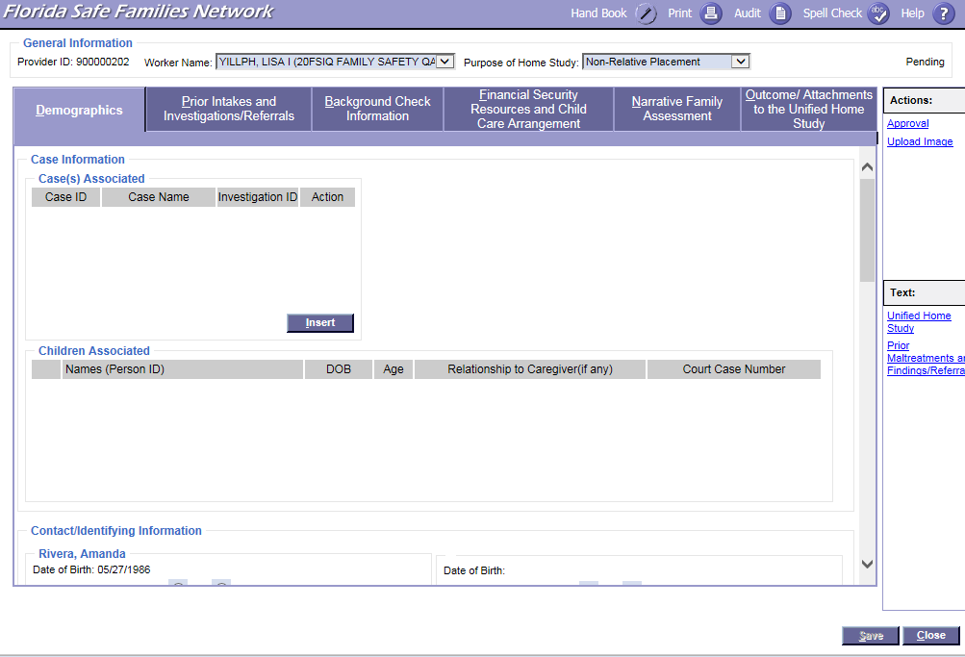

FSFN Screens
UHS Demographics tab:
Unified Home Study 3.10

Slide 11
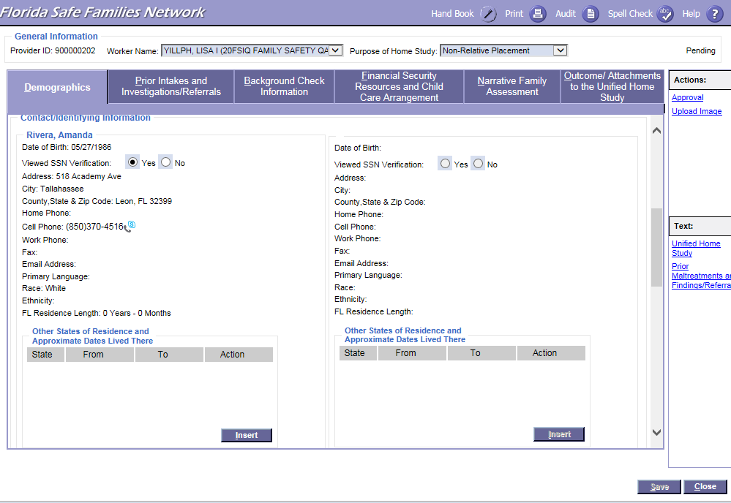
FSFN Screens
UHS Demographics tab:
Unified Home Study 3.11

Slide 12
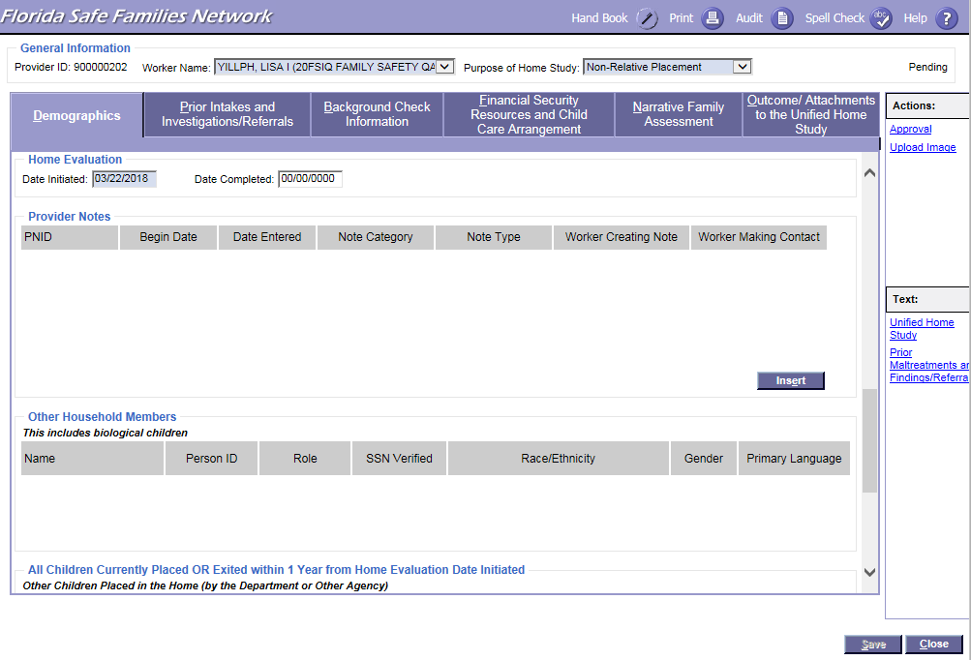
FSFN Screens
UHS Demographics tab:
Unified Home Study 3.12

Slide 13
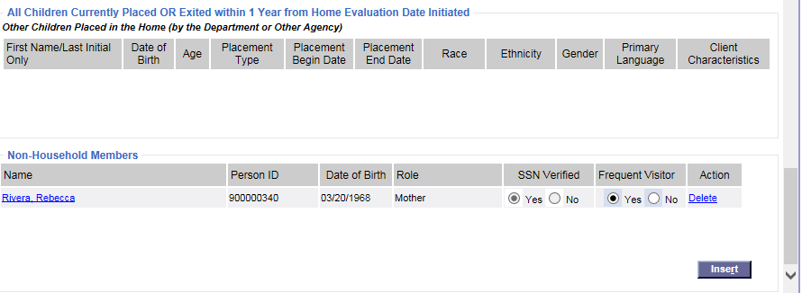
FSFN Screens
UHS Demographics tab:
Unified Home Study 3.13

Slide 14
Background
Checks
FSFN Tutorial
Unified Home Study 3.14

Slide 15
Background Checks
There are two types of relative/non-relative background checks when the child is in need of placement:
Emergency
Planned
Unified Home Study 3.15

Slide 16
Background Checks, con’t.
Abuse/ neglect record checks
Local criminal checks
Juvenile Justice information
FCIC
*NCIC
Fingerprint
submission
*NCIC for emergency background checks only
Unified Home Study 3.16

Slide 17
Analysis of Background Checks
A thorough review and analysis of all of the background information gathered provides Case Managers with the insight needed in order to ensure that the BEST possible placement is made for the child. When reviewing the criminal, abuse, and/or neglect records obtained, Case Managers must assess for patterns of criminal behavior that may place the child in danger.
Unified Home Study 3.17

Slide 18
Disqualifiers
While performing background checks, Child Welfare Professionals may find information that automatically disqualifies a person from being a placement candidate.
Unified Home Study 3.18

Slide 19
Disqualifiers, con’t.
Offenses that disqualify a person include:
Child abuse, abandonment, or neglect
Child pornography or other felony involving a child
Domestic violence
Homicide, sexual battery, or other felony involving violence
Unified Home Study 3.19

Slide 20
Disqualifiers, con’t.
Children cannot be placed with a person who has been convicted of a felony, within the last five years, within the following categories:
Assault
A drug-related offense
Battery
Resisting arrest with violence
Unified Home Study 3.20

Slide 21
Documentation
Within FSFN, Case Managers must document the records obtained and their thorough analysis of the background check results within the Background Check Information page.
Unified Home Study 3.21

Slide 22
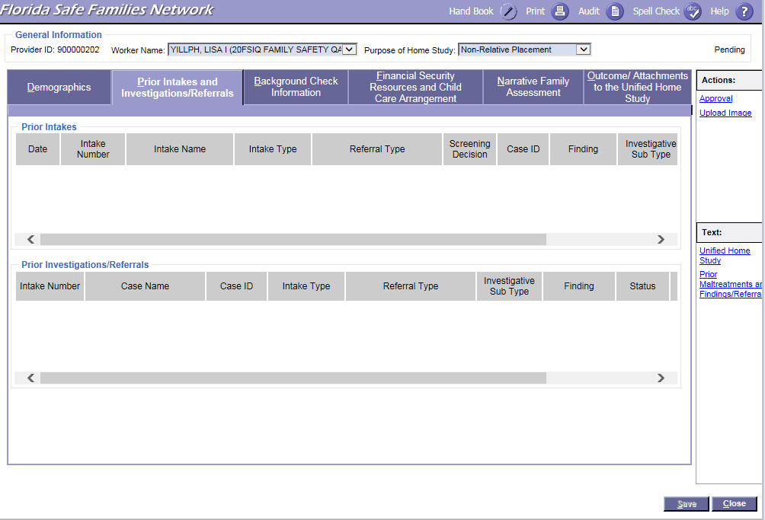
FSFN Screens
Prior Intakes Investigations/Referrals:
Unified Home Study 3.22

Slide 23
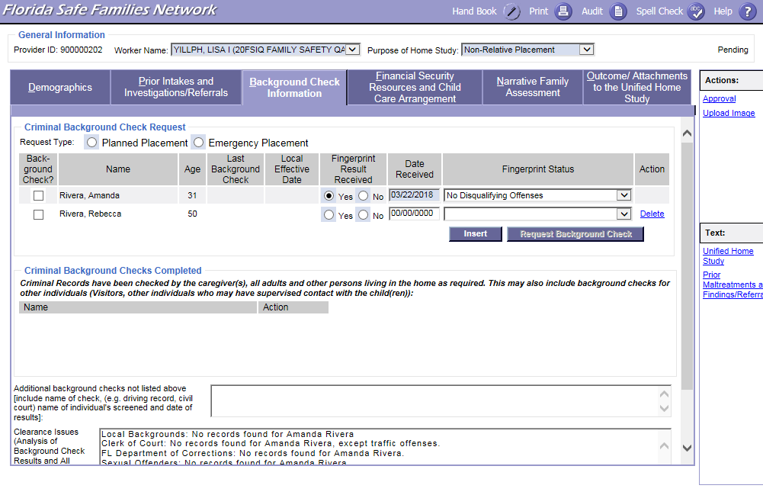
FSFN Screens
Requesting Background Checks:
Unified Home Study 3.23

Slide 24
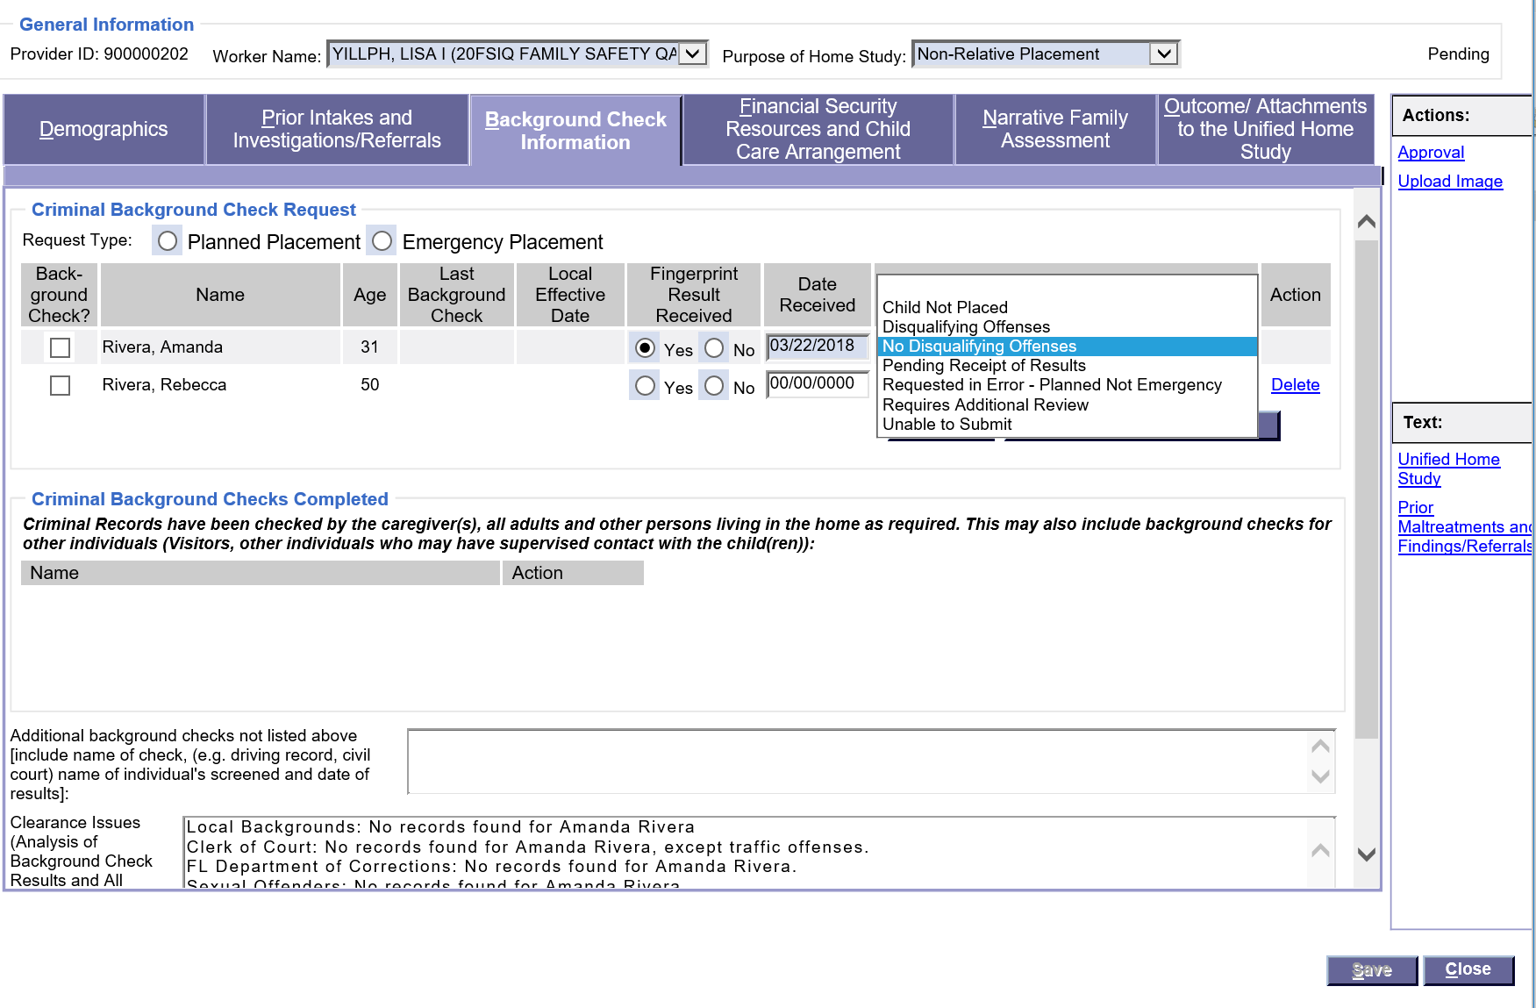
FSFN Screens
Documenting Background Check Results and Analysis:
Unified Home Study 3.24

Slide 25
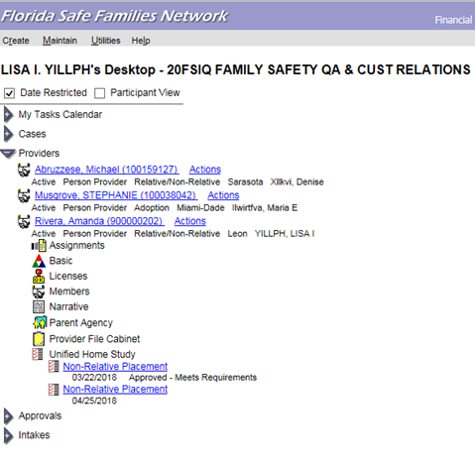
FSFN Screens
Updating criminal history dates:
Unified Home Study 3.25

Slide 26
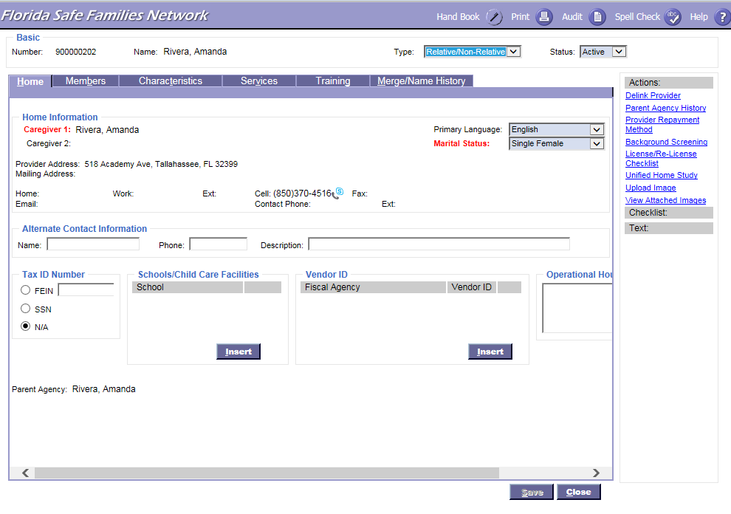
FSFN Screens
Updating criminal history dates:
Unified Home Study 3.26

Slide 27
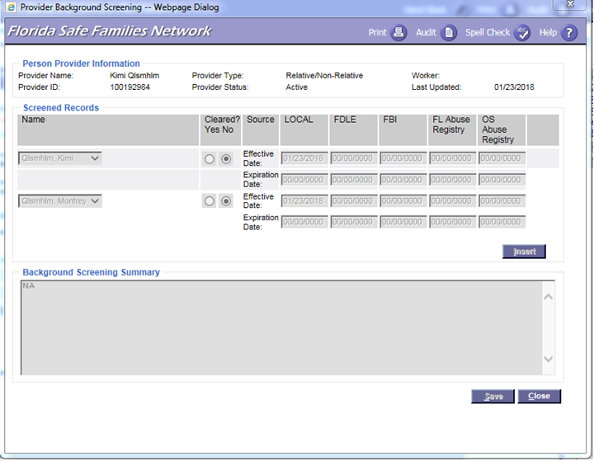
FSFN Screens
Where to insert clearance from different sources:
Unified Home Study 3.27

Slide 28
General Information Discussed during the Interview
Case Managers need to interview the prospective caregiver(s) to discuss:
The danger threats creating the child’s need for out-of-home care.
Any special medical needs the child has, including current medications.
The ability and willingness of the caregiver(s) to protect and care for the child. This includes whether or not the caregiver is aligned with the child.
Unified Home Study 3.28

Slide 29
General Information Discussed during the Interview, con’t.
The court proceedings involving the family.
Their rights and responsibilities as a caregiver.
Support and resources available to the caregiver, such as relative caregiver funds, Medicaid, at-risk daycare, etc.
Case Managers need to interview the prospective caregiver(s) to discuss:
Unified Home Study 3.29

Slide 30
Caregiver Supports
Medical Insurance (Medicaid)
“At-risk” Child Care Referral
“Child-only” Temporary Cash Assistance
Relative Caregiver Program (RCP)
Non-Relative Caregiver Program (NRCP)
DCF Tuition and Fee Exemption
Unified Home Study 3.30

Slide 31
Financial Security, Resources, and Child Care Arrangements
FSFN Tutorial
Unified Home Study 3.31

Slide 32
Financial Security, Resources, and Child Care Arrangements
Financial Breakdown
Additional Monthly Support
Household Information
Family Situation
Unified Home Study 3.32

Slide 33
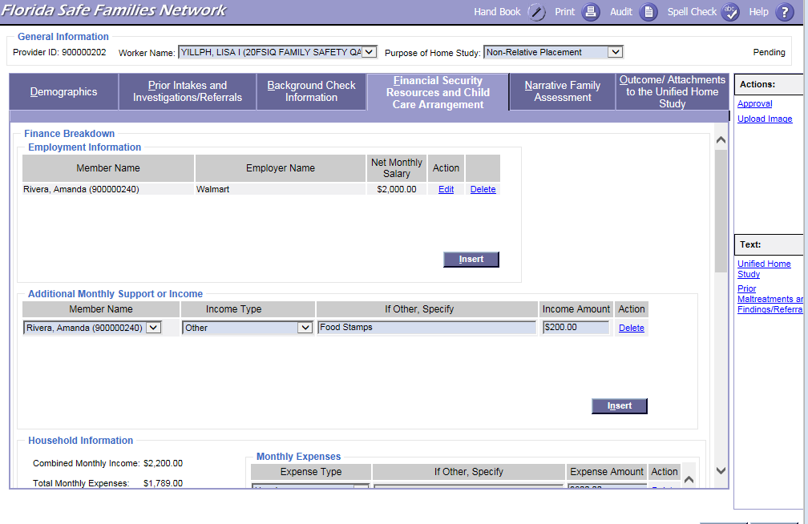
FSFN Screens
Employment Information:
Unified Home Study 3.33

Slide 34
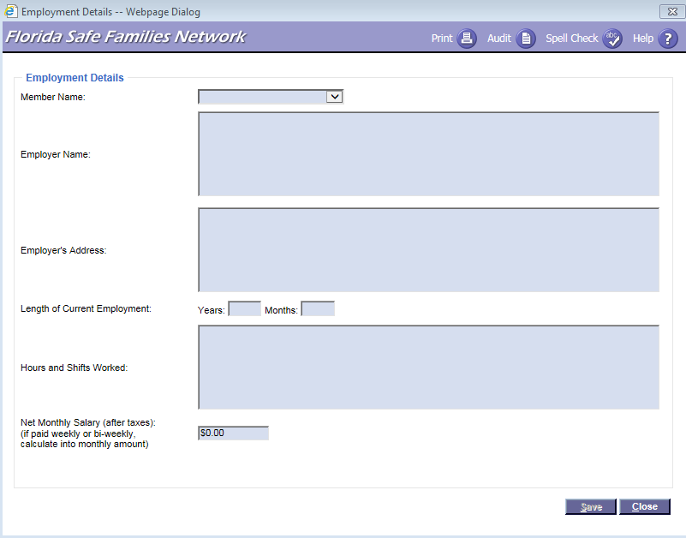
FSFN Screens
Adding Employment Details:
Unified Home Study 3.34

Slide 35
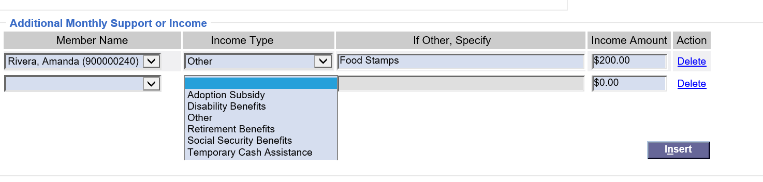
FSFN Screens
Adding Additional Monthly Support or Income:
Unified Home Study 3.35

Slide 36
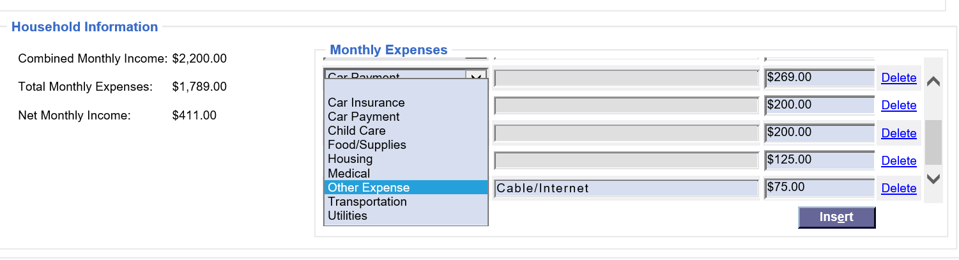
FSFN Screens
Adding Monthly Expenses:
Unified Home Study 3.36

Slide 37
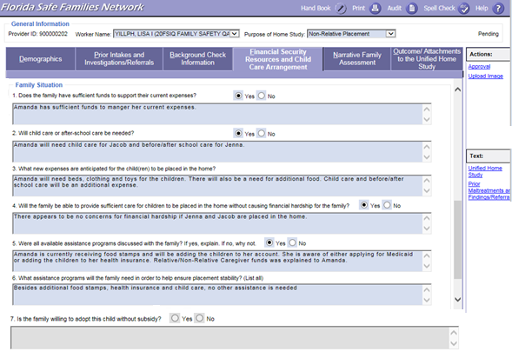
FSFN Screens
Family Situation:
Unified Home Study 3.37

Slide 38
Narrative Family Assessment
FSFN Tutorial
Unified Home Study 3.38

Slide 39
Narrative Family Assessment
Case Managers must conduct a narrative family assessment and gather the needed information to fully evaluate the caregiver’s ability to provide a safe and nurturing environment for the child.
Information should be gathered through an interview process.
Unified Home Study 3.39

Slide 40
Narrative Family Assessment, con’t.
The Narrative Family Assessment is split up into nine areas:
Assess Caregiver
Family History
Child History
Motivation
Children to Be Placed Interviews
Physical Environment
Education and Employment
References and Reviews
Family Support and Resources
Unified Home Study 3.40

Slide 41
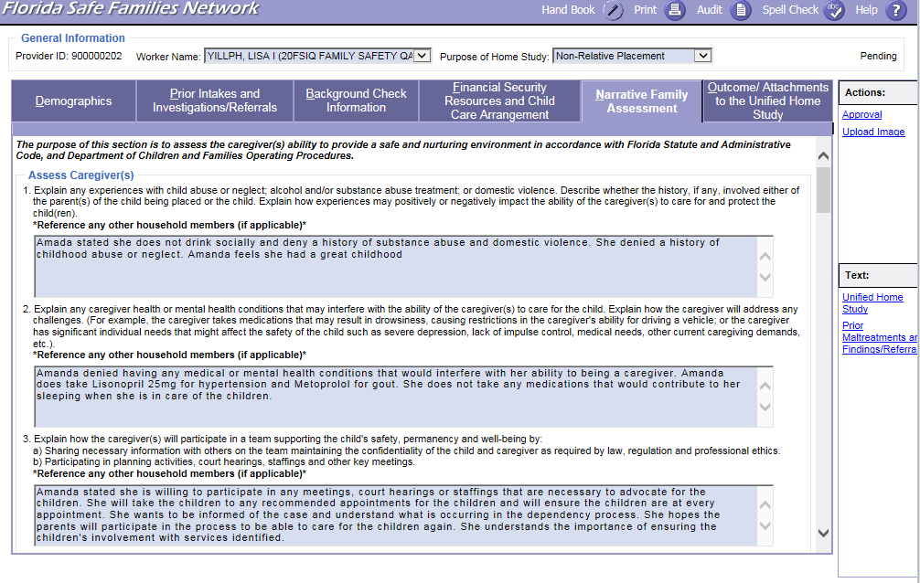
FSFN Screens
Narrative Family Assessment – Assess Caregiver(s) Questions:
Unified Home Study 3.41

Slide 42
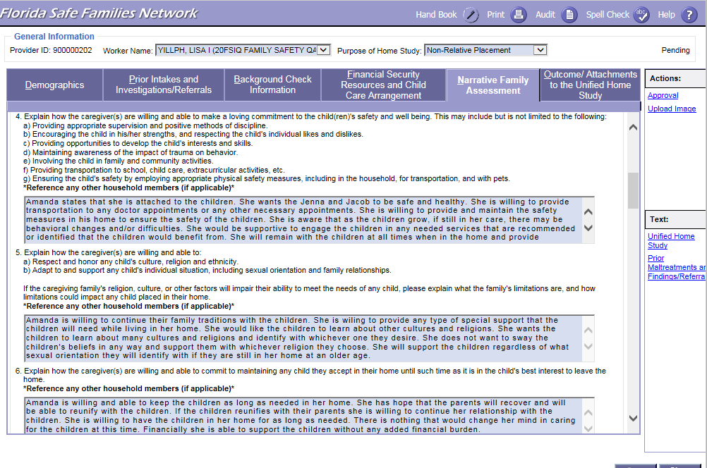
FSFN Screens
Narrative Family Assessment – Assess Caregiver(s) Questions:
Unified Home Study 3.42

Slide 43
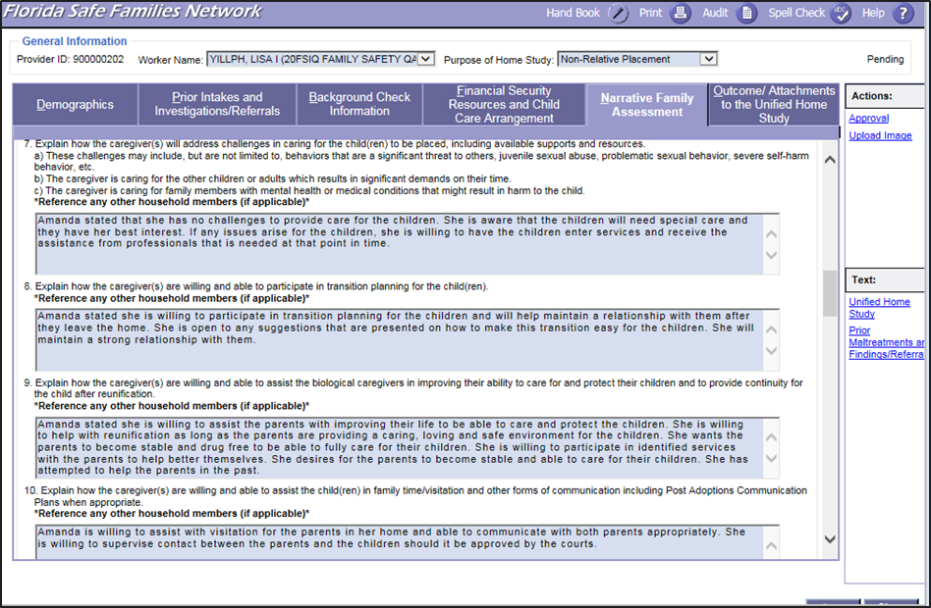
FSFN Screens
Narrative Family Assessment – Assess Caregiver(s) Questions:
Unified Home Study 3.43

Slide 44
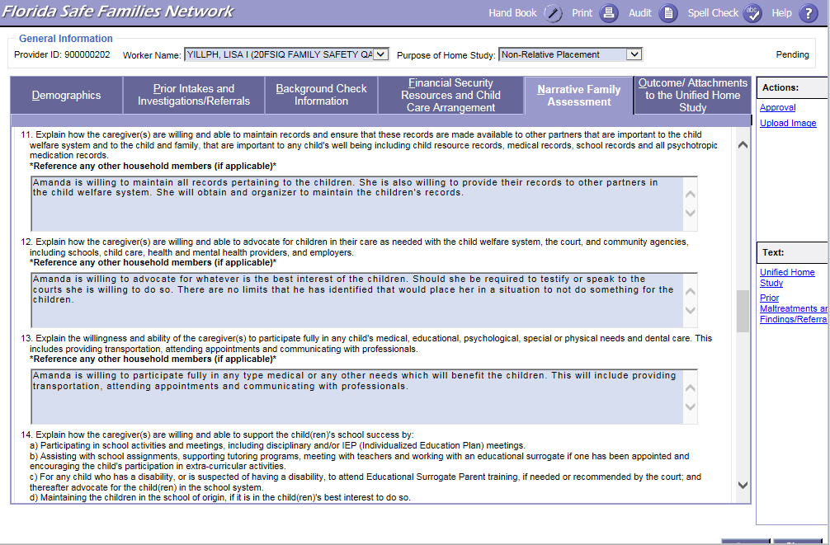
FSFN Screens
Narrative Family Assessment – Assess Caregiver(s) Questions:
Unified Home Study 3.44

Slide 45
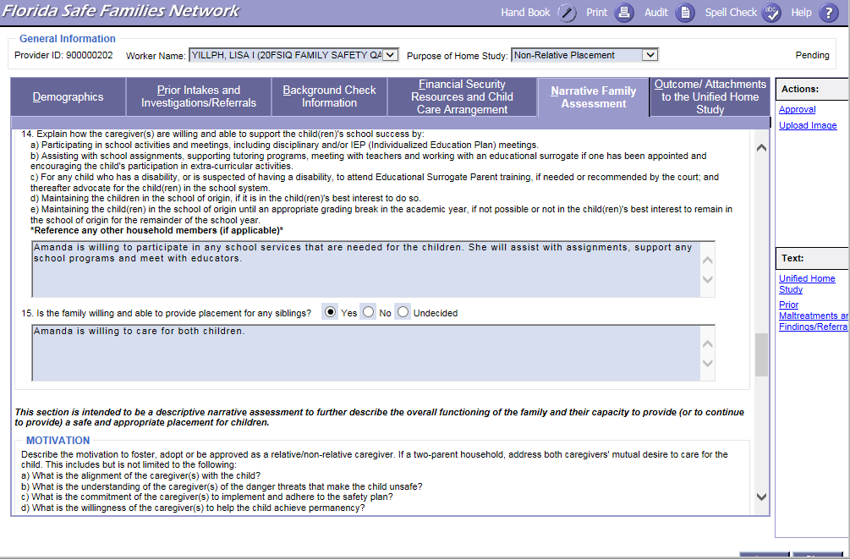
FSFN Screens
Narrative Family Assessment – Assess Caregiver(s) Questions:
Unified Home Study 3.45

Slide 46
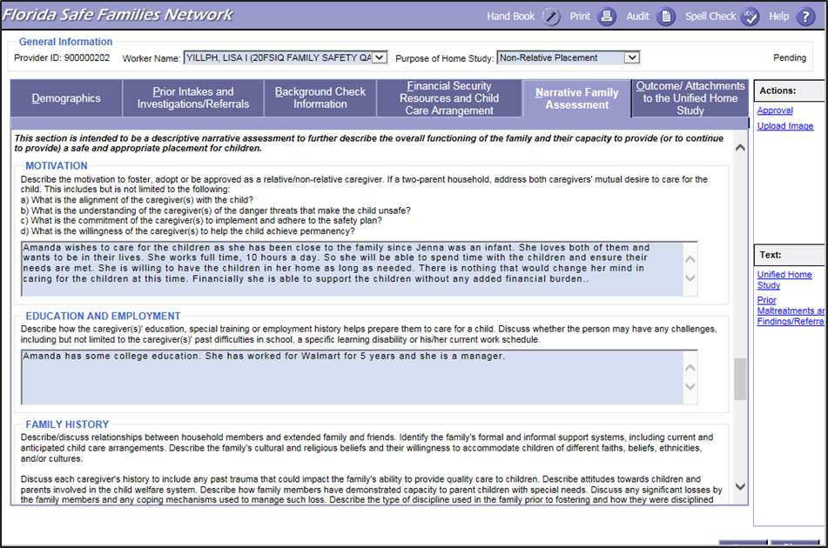
FSFN Screens
Narrative Family Assessment – Motivation and Education and Employment:
Unified Home Study 3.46

Slide 47
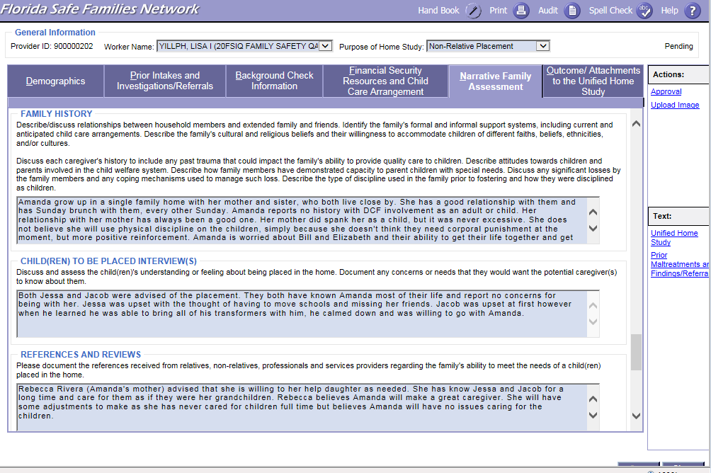
FSFN Screens
Narrative Family Assessment – Family History, Child(ren) To Be Placed Interview(s), and References and Reviews:
Unified Home Study 3.47

Slide 48
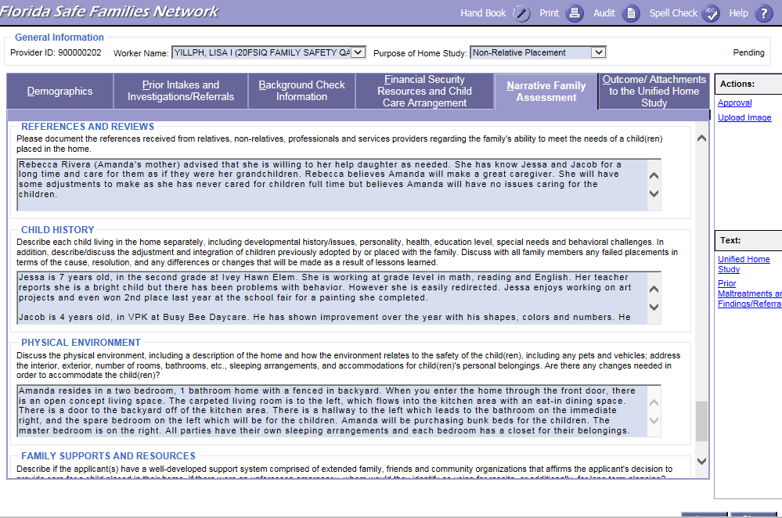
FSFN Screens
Narrative Family Assessment – Child History and Physical Environment:
Unified Home Study 3.48

Slide 49
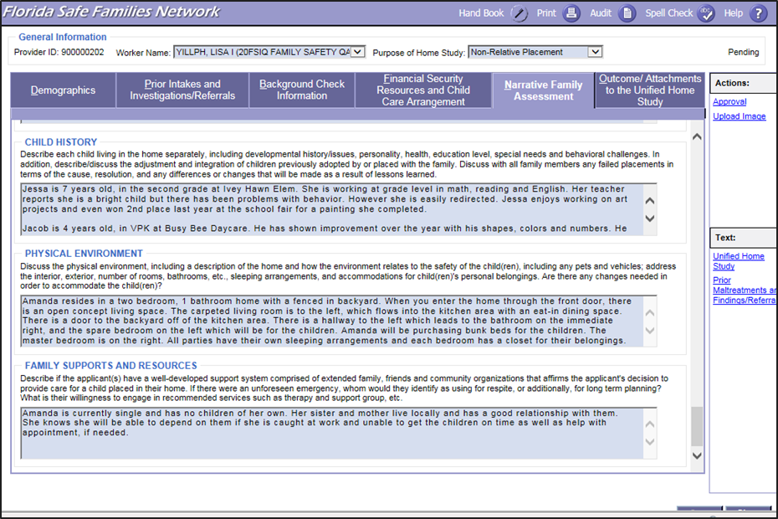
FSFN Screens
Narrative Family Assessment – Family Supports and Resources:
Unified Home Study 3.49

Slide 50
Activity A: Part 1 Jacob and Jenna Are Moving
Read the scenario. Note that the scenario is split into Part A and Part B. The first part is for everyone, and the second part should only be read by the Interviewee/Caregiver.
Select who will be the Case Manager/ Interviewer and who will be the Caregiver/Interviewee.
The interviewer must select up to five of the narrative assessment questions, and using the four interview phases, gather the needed information from the caregiver.
Unified Home Study 3.50

Slide 51

Finalizing the Relative/ Non-relative UHS
Unified Home Study 3.51

Slide 52
Attachments
FSFN Tutorial
Unified Home Study 3.52

Slide 53
Attachments
Attachments provide verification of information gathered and evidence of information shared with the caregivers.
The Outcome/ Attachments tab includes attachments that are in print form and external to the UHS and/or FSFN.
The attachments that are required depend on the type of Unified Home Study being completed.
Unified Home Study 3.53

Slide 54
Upload Requirements
Attachments | Upload Requirements for Relative/Non-relative UHS
Affidavit of firearm safety | Required: Signed Acknowledgement of Firearms/Safety Requirements
Consent to Release Information | Required: Use Agency Specific Release
Personal references | Optional to Upload Information
Referrals | Optional to Upload Information Provided to Caregiver
Receipts of Rights and responsibilities | Optional to Upload Information Provided to Caregiver
Receipt of Grievance Brochure | Optional to Upload Information Provided to Caregiver
Water Addendum | Optional to Upload Information Provided to Caregiver
Relative Caregiver Program Information | Optional to Upload Information Provided to Caregiver
Adoption-Child Study | N/A
Adoption-Subsidy Acknowledgement form | N/A
Affidavit of Good Moral Character | N/A
Florida Adoption Assistance Program | N/A
Information Packet Sent-Adoptive Home | N/A
Information Packet Sent-Foster Home | N/A
Florida Adoption Reunion Registry | N/A
TANF information | N/A
Unified Home Study 3.54

Slide 55
Signatures, Recommendations, and Final Approvals
Once all information required has been gathered and assessed, Child Welfare Professionals must ask the caregiver to review and sign the home study.
If known, it is at this time that Child Welfare Professionals inform the caregiver of any concerns or changes that might affect the anticipated outcome of the home study.
Signatures
Unified Home Study 3.55

Slide 56
Signatures, Recommendations, and Final Approvals, con’t.
Once signed by the caregiver(s), Case Managers, and supervisors, the entire UHS, including the signature page, must be uploaded into the UHS page in FSFN within two business days.
Signatures
Unified Home Study 3.56

Slide 57
Signatures, Recommendations, and Final Approvals, con’t.
In the Recommendation group box on the FSFN UHS page, the Child Welfare Professional selects an appropriate recommendation from the Recommendation drop-down choices:
Application Withdrawn
Denied - Criminal Disqualifier
Duplicate - Created in Error
Approved - Meets Requirements
Denied - FSFN Disqualifier
Approved - Review Comments
Denied - Review Comments
Recommendations
Unified Home Study 3.57

Slide 58
Signatures, Recommendations, and Final Approvals, con’t.
The supervisor reviews the home study in FSFN to determine that appropriate interviews, background checks and analysis, and assessment of caregiver(s) have been completed.
For the approval/denial process, Child Welfare Professionals and supervisors must enter a justification for approval or denial in the Outcome text box.
Final Approvals
Unified Home Study 3.58

Slide 59
Signatures, Recommendations, and Final Approvals, con’t.
The supervisor has the authority to approve or deny a completed home study regardless of a Child Welfare Professional’s recommendation.
Final Approvals
Unified Home Study 3.59

Slide 60
Final Approvals, con’t.
In the Outcome group box on the FSFN UHS page, the supervisor selects an appropriate conclusion from the Outcome drop-down choices:
Application Withdrawn
Denied - Criminal Disqualifier
Duplicate - Created in Error
Approved - Meets Requirements
Denied - FSFN Disqualifier
Denied - Court Approved
Approved - Review Comments
Denied - Review Comments
Unified Home Study 3.60

Slide 61
Final Approvals, con’t.
The Child Welfare Professional Supervisor must approve their outcome by completing the approval routing process.
If the Child Welfare Professional’s supervisor is not available, they can choose an alternate supervisor.
Child Welfare Professionals cannot approve their own home study.
Unified Home Study 3.61

Slide 62
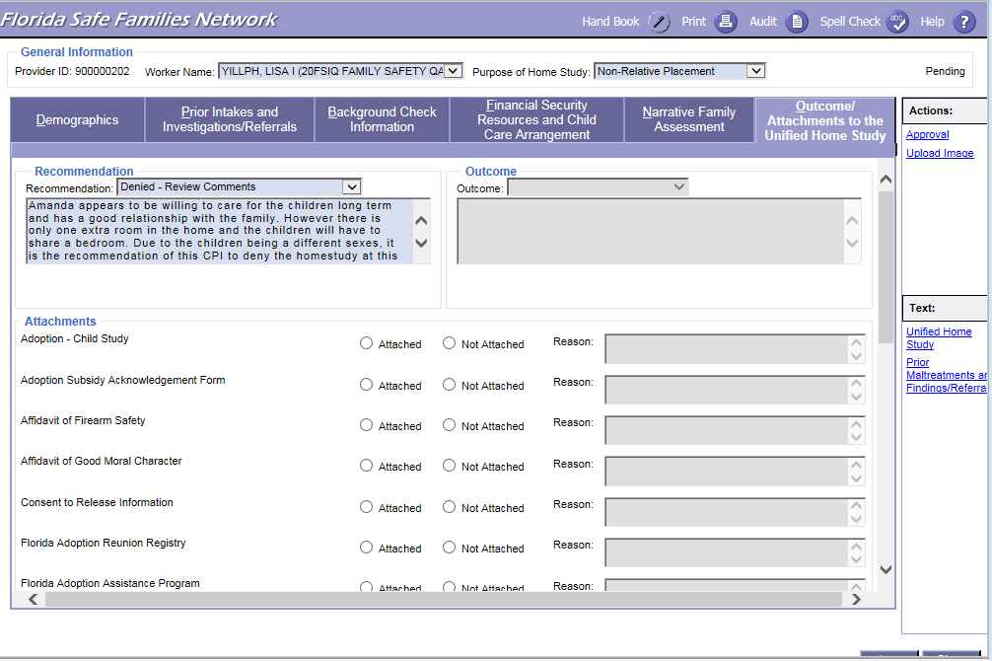
FSFN Screens
Outcome/Attachments, Recommendations, and Approval:
Unified Home Study 3.62

Slide 63
Filing the UHS with Court
A copy of the signed home study, copies of criminal records that can be shared, and any additional attachments obtained are submitted to CLS to file with the court.
The home study must be provided to CLS in conjunction with any request for placement of a child with a relative/non-relative.
Unified Home Study 3.63

Slide 64
Copy Function
FSFN Tutorial
Unified Home Study 3.64

Slide 65
Copy Function
The information that will copy over includes:
Purpose of home study
Narrative Family Assessment information, except for non-required questions
Finance Breakdown, Additional Monthly Support or Income, and Household Information from the Financial Security Resources tab
Other states of residence
Background check narrative
FSFN will now have the functionality to copy over selected fields from the most recent approved home study in FSFN.
If there is already a pending home study, a validation message will appear to ensure a new one is needed.
Unified Home Study 3.65

Slide 66
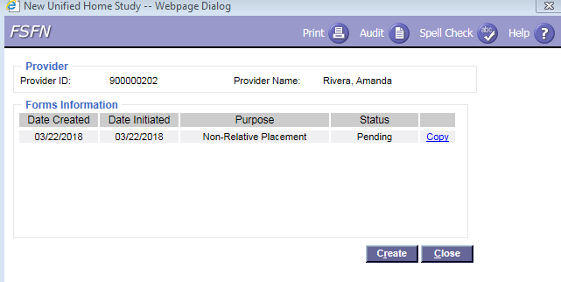
FSFN Tutorial
Unified Home Study 3.66

Slide 67
Addendum - Not Adoption
Addendum addresses all changes that have occurred in the home within the past year.
Examples include:
Move to new home (change location)
Change in household circumstances
New household members
Annual renewal of UHS
The home study must be provided to CLS in conjunction with any request for placement of a child with a relative/non-relative.
Unified Home Study 3.67

Slide 68
Activity A: Part 2 Jacob and Jenna Are Moving
Read the scenario.
Create and complete Relative/Non-relative UHS in FSFN where both the Case Manager and Case Manager Supervisor recommends the UHS.
Unified Home Study 3.68

Slide 69

Questions

